Slide 1
MINHYEOK X IQBAL
AI FOR GOOD | SDG 10 - REDUCED INEQUALITY
Inclu
FIND YOUR PLACE, FEEL INCLUDED.

Slide 2


Social Inclusion
SDG 10. 2
THE UN DEFINES TARGET 10.2 AS:
“By 2030, empower and promote the social, economic and political inclusion of all...”
WHY Inclu FITS 10.2
Inclu is addressing a more specific aspect of social inclusion,
while reducing barriers to social and community participation.

Slide 3
Problem
Unequal access to community connections and local support
INEQUALITY IN SOCIAL INCLUSION
Some people, particularly newcomers or people facing language/social barriers, may have more difficulty discovering and accessing community opportunities and support.

Slide 4
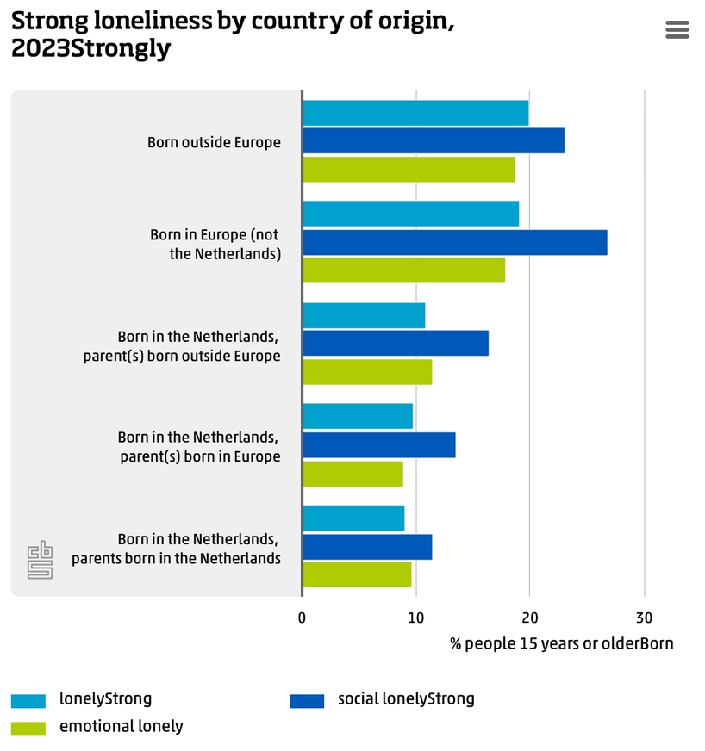
Problem 1
The Social-Loneliness Gap among Migrants born Outside the NL
STRONG LONELINESS
Strong loneliness is over 2X higher among non-European migrants (19.9%) than Dsutch-born people (9.1%).
Target Group
People aged 15 and older born outside the NL (both European & non-European origin)
(CBS, 2024)

Slide 5
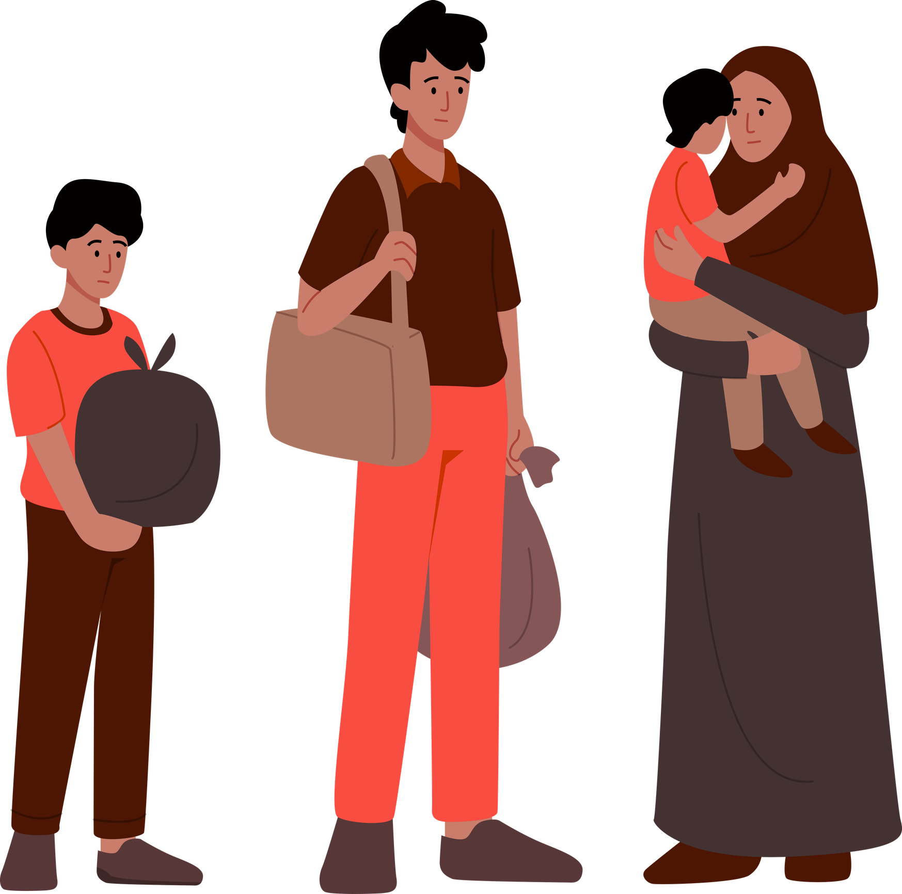
Problem 2
The Participation Gap in Community Activities among people with a Migration background
UNEQUAL COMMUNITY PARTICIPATION
Migrants participate less in community life:
28% join associations monthly vs. 46% of Dutch-origin residents,
and 35% volunteer vs. 50%.
(CBS, 2024)
Target Group
People with migration background (first & second generation) in NL

Slide 6
Target Group
Recent Newcomers & Migrants in The Hague
  Limited Dutch language proficiency
  Limited contact with Dutch-speaking social networks
  Refugees, family migrants, and labour migrants
Rationale
58% of The Hague’s residents have a migration background (Municipality of The Hague)
The Hague has the highest loneliness rate among the four major Dutch cities (GGD Haaglanden, 2025)

Slide 7

Solution: Inclu
An AI-powered guide that helps people discover relevant community resources and opportunities
EASIER ACCESS TO SOCIAL PARTICIPATION AND COMMUNITY INCLUSION
  AI-powered Recommendations tailored to regidents’ interests, language, age, and location.
  Categorising diverse communities with easy guides including joining steps & links.

Slide 8
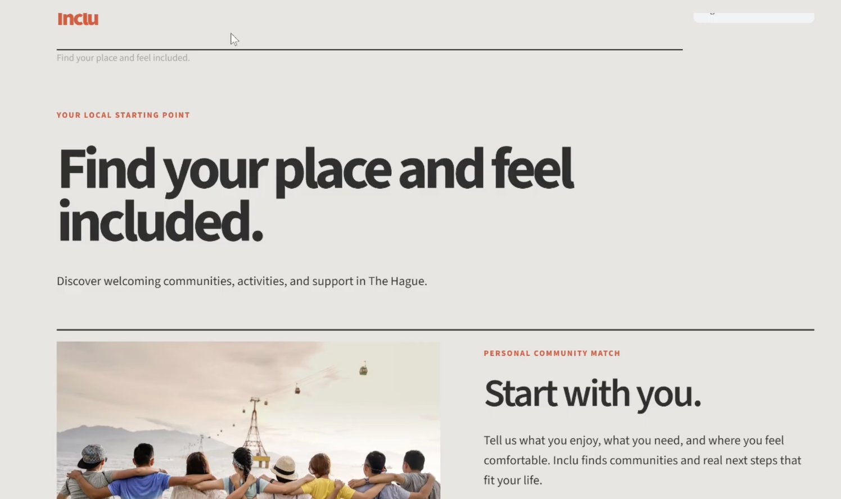
Demo
Demo Link
https://www.youtube.com/watch?app=desktop&v=mwnZlO1FAUs

Slide 9
Ethical Reflaction
  Risk of AI generating inaccurate or outdated community resources.
  Risk of stereotyping migrants or socially isolated people.
  Risk of excluding people who lack digital literacy or internet access.
  Privacy concerns when users describe personal circumstances.

